Slide 1

ECE2050 Digital Logic and Systems Tutorial 5
Wangqian Chen
Contact: wangqianchen@link.cuhk.edu.cn
Office Hour: 16:00-17:00 Wed., ZX305

Slide 2
Combinational Logic Analysis
Outline
Analyze basic combinational logic circuits and write the Boolean output expression.
Develop a truth table from the output expression for a combinational logic circuit.
Design a combinational logic circuit.
Analyze the operation of logic circuits with pulse inputs.

Slide 3
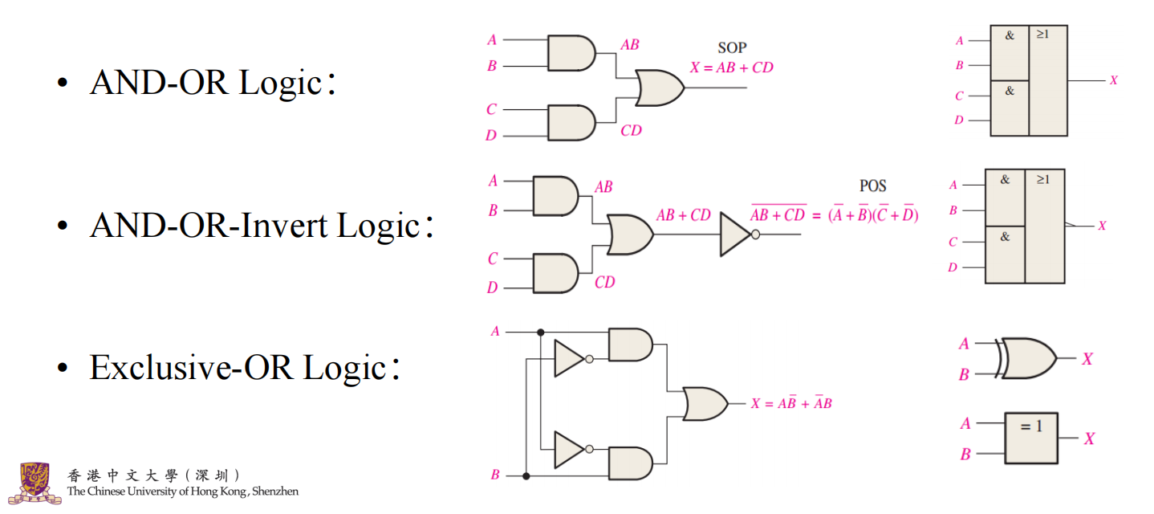
Basic Combinational Logic Analysis

Slide 4
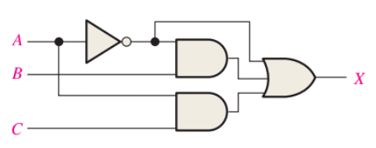
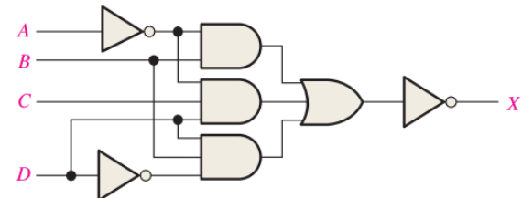
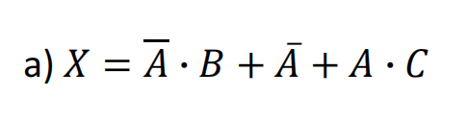
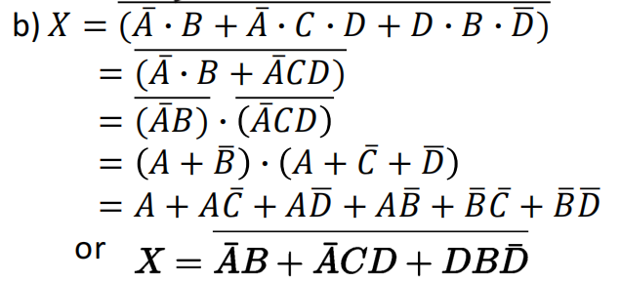
Basic Combinational Logic Analysis
Q1. Write the output expression for each circuit in Figure 5–54

Slide 5
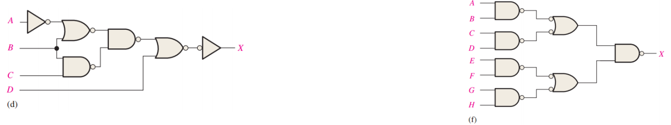
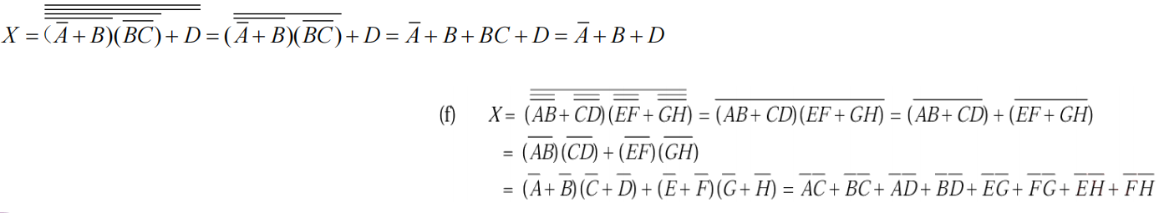
Basic Combinational Logic Analysis
Q2. P303 Figure 5–56（d） and Figure 5–56（f）

Slide 6
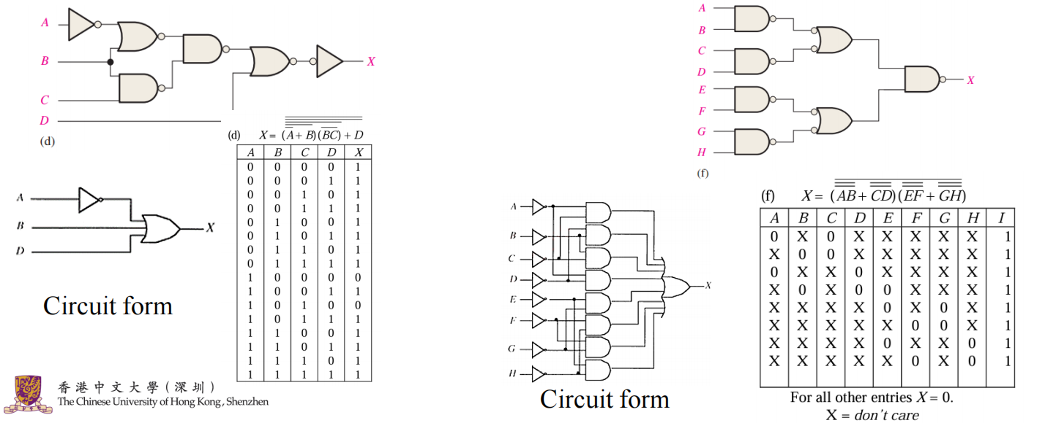
Basic Combinational Logic Analysis

Slide 7
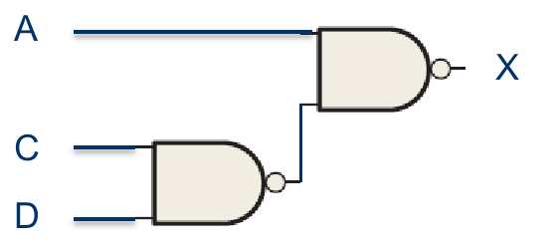
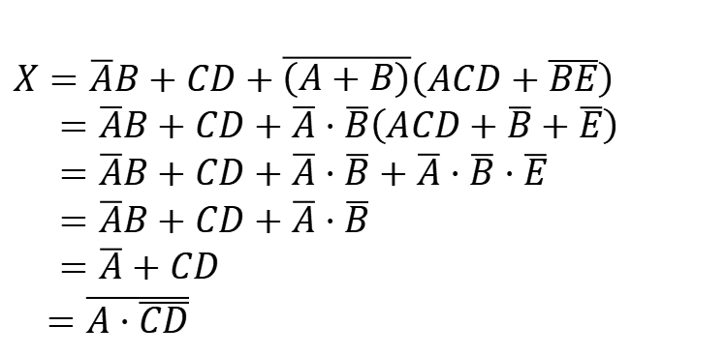
Implementing Combinational Logic
Q3. Use NAND gates, NOR gates or combinations of both to implement the following logic expressions as stated:
$$X=\overline{A}B+CD+\overline{\left(A+B\right)}(ACD+\overline{BE})$$
$X=\overline{A}B+CD+\overline{\left(A+B\right)}\left(ACD+\overline{BE}\right)$
$=\overline{A}B+CD+\overline{A}⋅\overline{B}\left(ACD+\overline{B}+\overline{E}\right)$
$=\overline{A}B+CD+\overline{A}⋅\overline{B}+\overline{A}⋅\overline{B}⋅\overline{E}$
$=\overline{A}B+CD+\overline{A}⋅\overline{B}$
$=\overline{A}+CD$
$=\overline{A⋅\overline{CD}}$

Slide 8
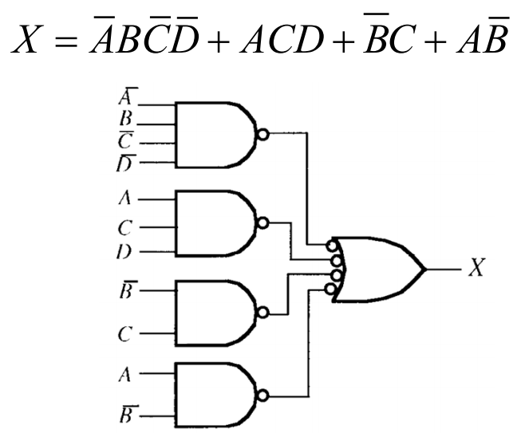
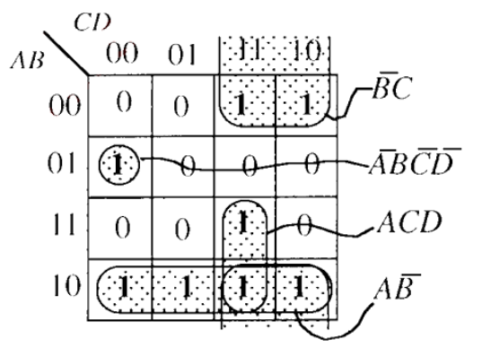
Implementing Combinational Logic
Q4. Implement a logic circuit for the truth table

Slide 9
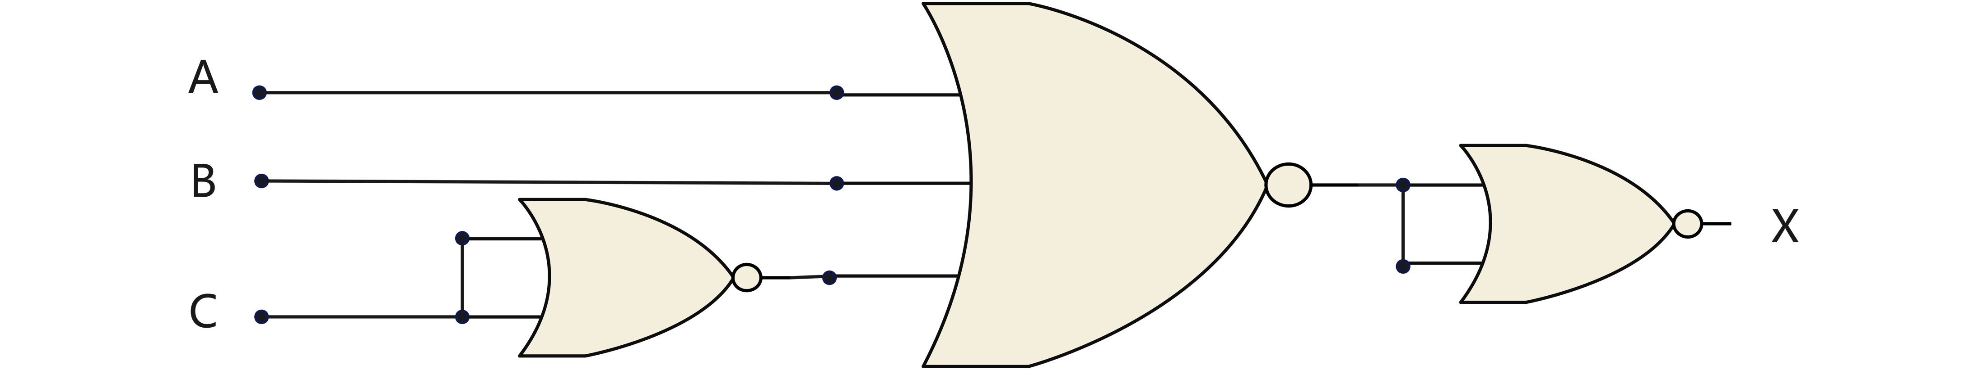
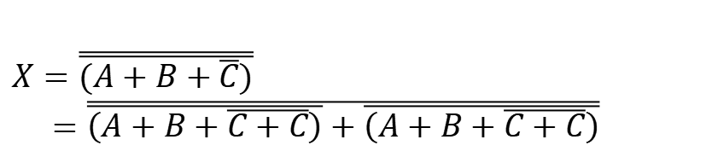
Implementing Combinational Logic
Q5. Show how the following expressions can be implemented as stated using only NOR gates
$$X=A+B+\overline{C}$$
$X=\overline{\overline{(A+B+\overline{C})}}$
$=\overline{\overline{\left(A+B+\overline{C+C}\right)}+\overline{\left(A+B+\overline{C+C}\right)}}$

Slide 10
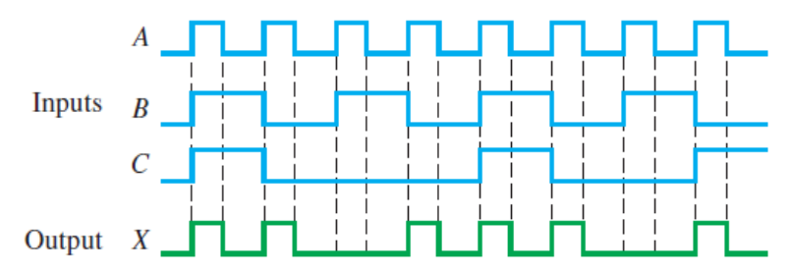

Pulse Waveform Operation
Q6. For the input waveforms in the following figure, what logic circuit will generate the output waveform shown?
The logic circuit is:
$$X=A⋅\left(BC+\overline{B}\overline{C}+\overline{B}C\right)=A⋅(\overline{B}+C)$$

Slide 11
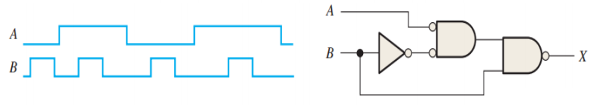
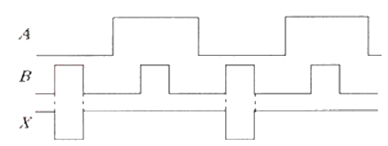
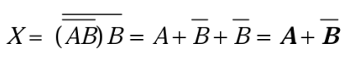
Pulse Waveform Operation
Q7. Write down the output waveform

Slide 12
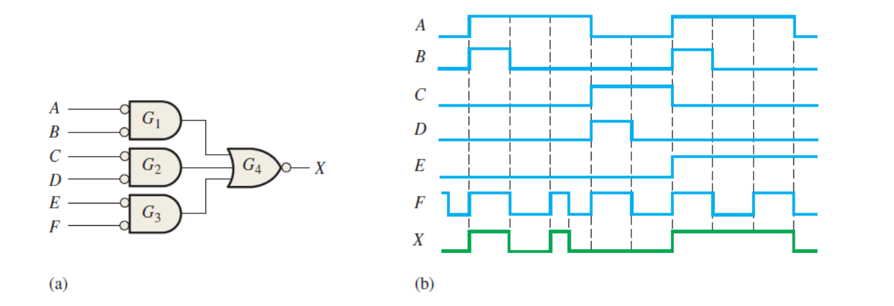
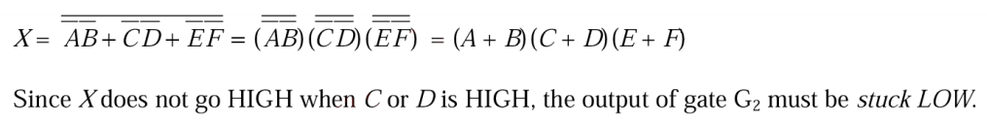
Basic Combinational Logic Analysis
Q8. Figure (a) is a logic circuit under test. Figure (b) shows the waveforms as observed on a logic analyzer. The output waveform is incorrect for the inputs that are applied to the circuit. Assuming that one gate in the circuit has failed, with its output either an apparent constant HIGH or a constant LOW. Determine the faulty gate and the type of failure.

Slide 13
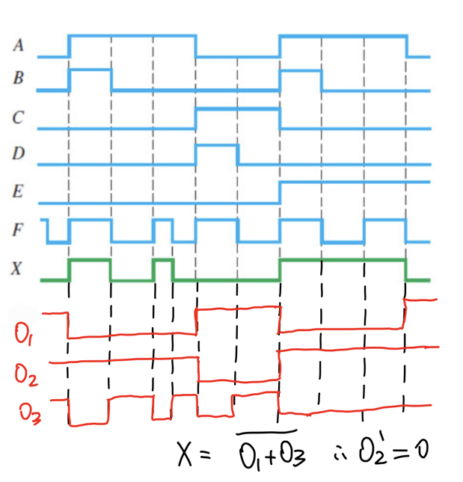
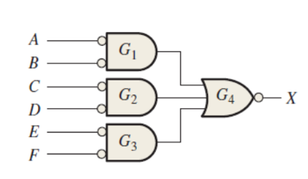
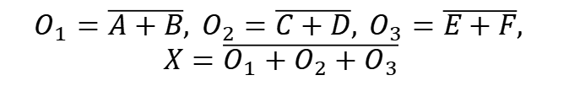
Basic Combinational Logic Analysis
Q8. For the input waveforms in the following figure, what logic circuit will generate the output waveform shown?
$$O_{1}=\overline{A+B}, O_{2}=\overline{C+D}, O_{3}=\overline{E+F},$$
$$X=\overline{O_{1}+O_{2}+O_{3}}$$

Slide 14
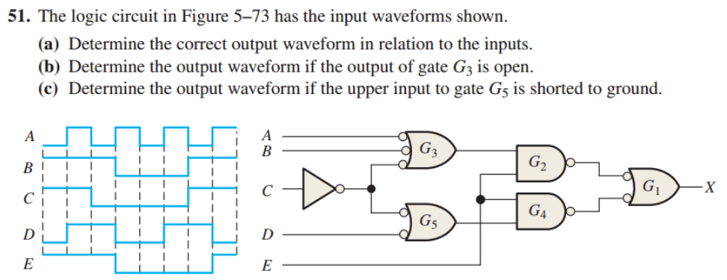
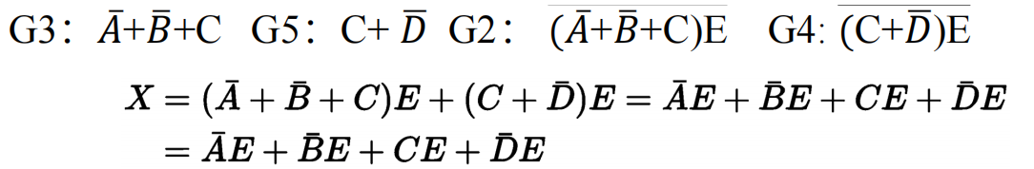
Basic Combinational Logic Analysis
Q9.

Slide 15
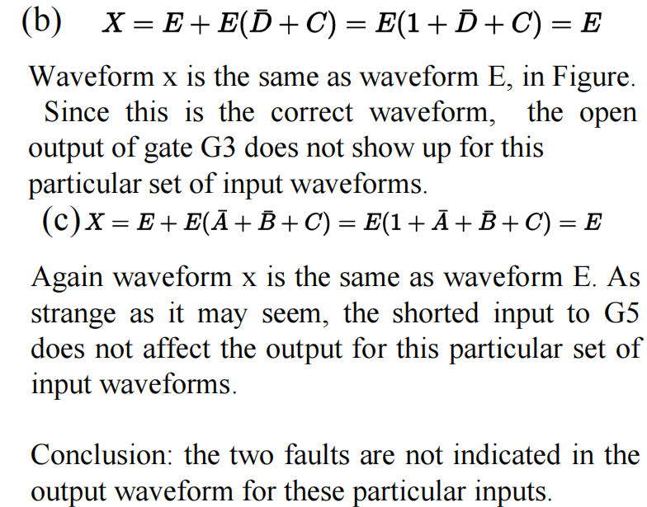
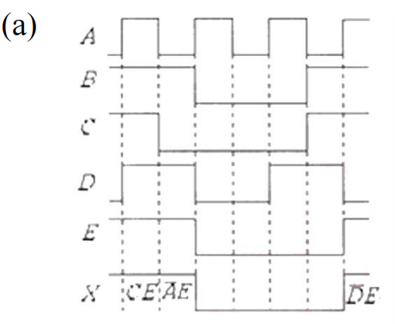
Basic Combinational Logic Analysis
Q9.

Slide 16
Thank You!

